Slide 1
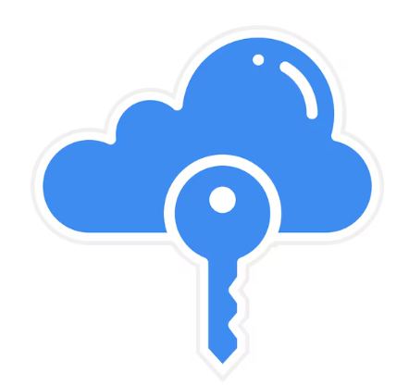
DevAccess: Secure, Efficient Developer Access Management
Presented by Jan Michael Cheng

Slide 2

The Challenge: Managing Access is Slow and Risky
Developers often need temporary access to staging or production.
Current approval processes are manual, insecure, and time-consuming.
Managers lack visibility and audit trails.
This leads to bottlenecks and potential security breaches.

Slide 3
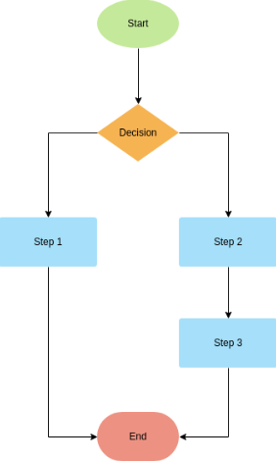
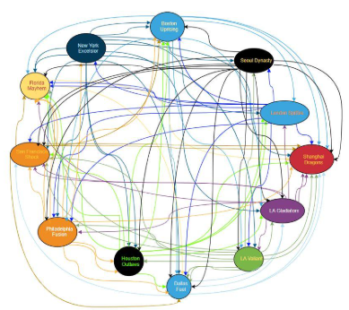
What if Access Requests Were Fast, Auditable, and Secure?
Automation reduces wait time from hours → seconds.
Built-in approvals meet compliance requirements.
Centralized system logs every access.
Improves productivity and trust between Dev & Ops teams.

Slide 4
Introducing DevAccess
Web-based platform where developers submit access requests.
Managers approve with one click via dashboard.
Upon approval, DevAccess automatically grants temporary credentials.
All actions are logged for audits.

Slide 5
Simple 3-Step Workflow
Developer requests access
Manager approves
System auto-grants temporary access

Slide 6
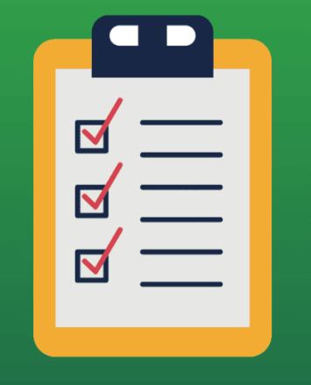
Secure by Design
Role-based permissions
Approval workflows
Time-limited credentials
Full activity logs
Email / Slack notifications
Integration with AWS, GitHub, etc

Slide 7
Developer Dashboard
XYZ Access
Approved
Production Access
Request
ABC Access
Pending

Slide 8
Manager Approval & Access Log
XYZ Access
Revoke
ABC Access
Approve

Slide 9
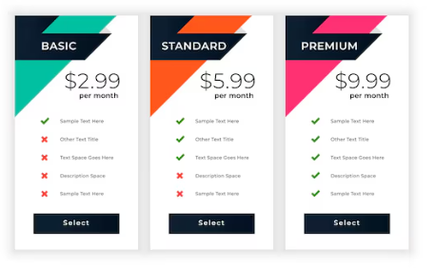
Turning DevAccess into a SaaS Product
Offered as a cloud-based subscription service
Companies pay per active developer/month
Secure API integration with their existing IAM (AWS IAM, Azure AD)
Potential partnerships with DevOps platforms

Slide 10
Why DevAccess Matters
Saves time and reduces security risks
Fits modern DevOps culture of automation
Scales easily for global teams
“With DevAccess, security and speed no longer compete — they collaborate.”

